Slide 1


Automated Android Malware Analysis Framework
2.0
Idan Revivo - @idanr86

Slide 2

A Little Bit About Me
Mobile Security Research Team Leader at IBM-Trusteer
Focusing on financial mobile malware.
previously a mobile malware researcher at Checkpoint's malware research team.
I specializes in Android internals and sandboxing techniques.
bachelor's degree in Software Engineering, specializing in Mobile Systems.

Slide 3

The Problem: Mobile Malware is On The Rise
Manual malware analysis has always been a slow process – taking days and even weeks per sample rendering the task impractical even for a small sample pool.
Every single day thousands of new malware variants are being created, and we need a fast way to sort, analyze, catalog and understand their behavior.

Slide 4

The Solution: automation
Our solution is to automate as much of the analysis process as possible – following the success of this approach for PC malware.
The goal is to create a system that would take an app and produce a report describing exactly what it does when it’s run, specifically pointing out anything “fishy”. This allows us to perform an initial analysis with no human intervention.

Slide 5

About the project
Originally contributed by Checkpoint Software Technologies
The project originally was developed in Checkpoint by:
Idan Revivo - @idanr86
Ofer Caspi - @shablolForce
The project started in 2014 when were tasked with reviewing all sandbox solutions in market for purchase.
We decided that non of the system were flexible and customizable like we as a researchers need.
So Built an analysis platform ourselves.

Slide 6


CuckooDroid
CuckooDroid is built on top of Cuckoo Sandbox the Open Source software for automating analysis of suspicious files, CuckooDroid brings to cuckoo the capabilities of execution and analysis of android application.

Slide 7
All In One Analysis Framework
Static Analysis
Anti-Analysis Detection
Dynamic Analysis
Traffic Analysis
Virtualization Support
Intelligence Gathering
Behavior Analysis
Malware Detection and Configuration Extraction

Slide 8
Analysis Flow
Stage 1
Submission – Submitting APK sample for analysis
Stage 2
Dynamic Execution - The sample is then executed and monitored inside a virtual machine
Stage 3
Processing - Customizable Python modules aggregate the raw results from the sandbox into actionable data points
Stage 4
Stage 5
Behavioral Signatures – Signatures trying identify a predefined pattern that might represent a particular malicious behavior or indicator of interest.
Reporting - Generates reports in JSON, HTML, MongoDB, and other formats.

Slide 9




Analysis Flow
- Built in
- Planed
Processing Modules
Signatures
- Ready
Dynamic Execution
Products
Mongo DB
Manifest
Native Code
pcap
Google Play
Dynamic Code
API Calls
Static Api Calls
Reflection Code
Dynamic Api Calls Aggregation
Dangerous permission
HTML Report
Screenshots
play Google diff
Memory dump
Files
Network
Virus Total Detected
Apk File
JSON Report
Virus Total
Unknown permission
Etc…
Etc….

Slide 10
Static Analysis
Static Analysis
APK File Tree
Strings
API Calls
Manifest
Certificate

Slide 11
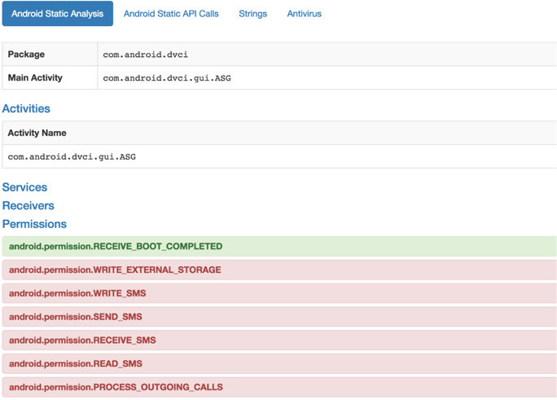
Static Analysis

Slide 12
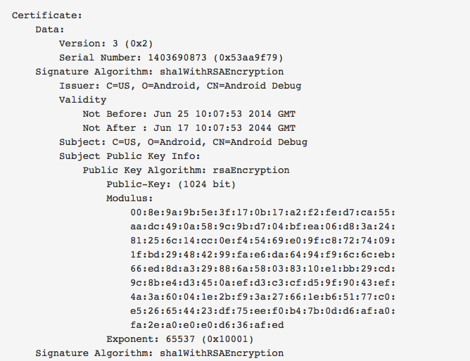
Static Analysis

Slide 13
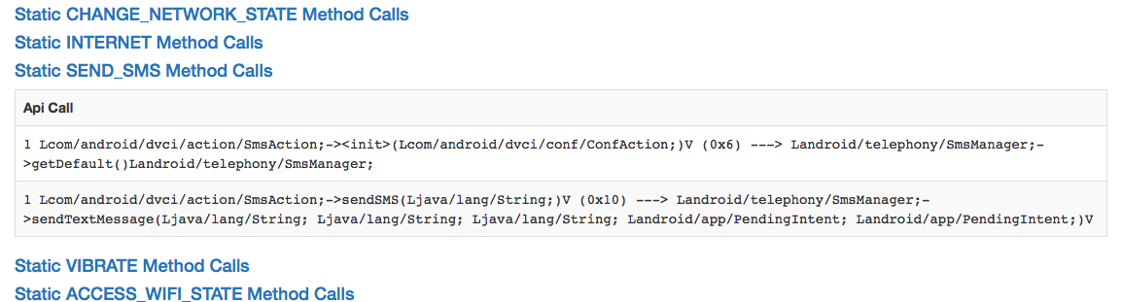
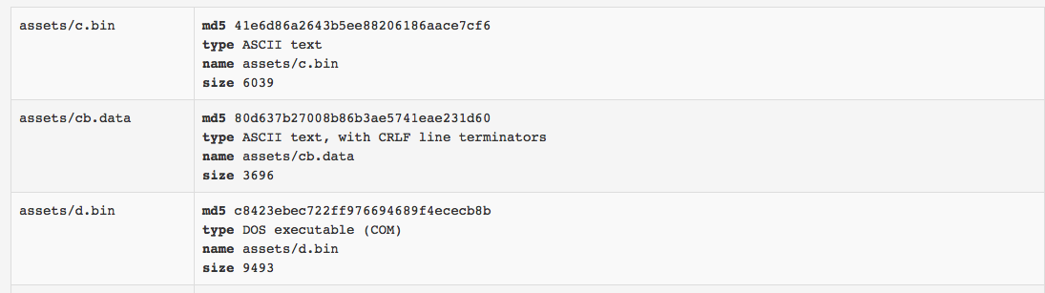
Static Analysis

Slide 14
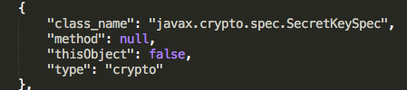
Dynamic Analysis
Based on Droidmon - Dalvik API Monitoring Framework
Highly configurable hooking engine – easy to add new hooks
Hooks list can be configured for each analysis
Dynamic Unpacking of most Android packers
Dynamic Analysis
Crypto
Reflection calls
Files accessed
Shell Commands
SMS Messages
Accounts
Loaded Files
Shared Preferences

Slide 15
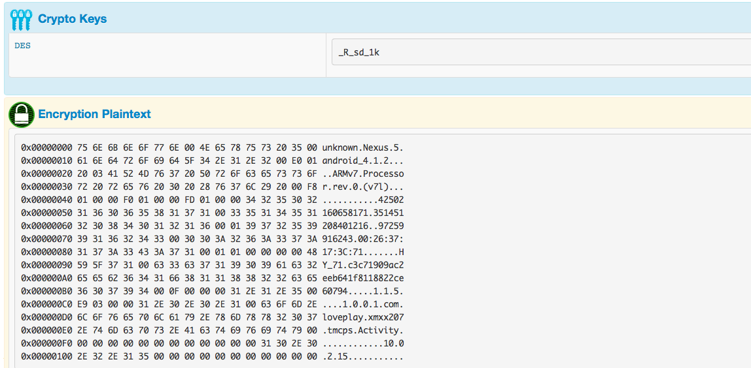
Dynamic Analysis

Slide 16
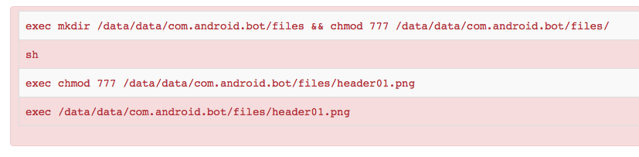
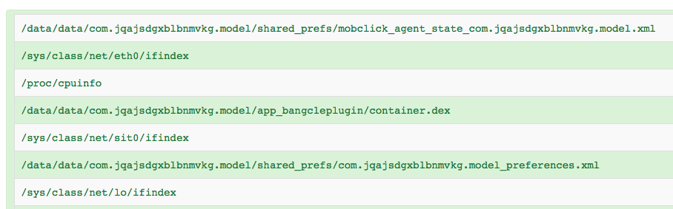
Dynamic Analysis

Slide 17
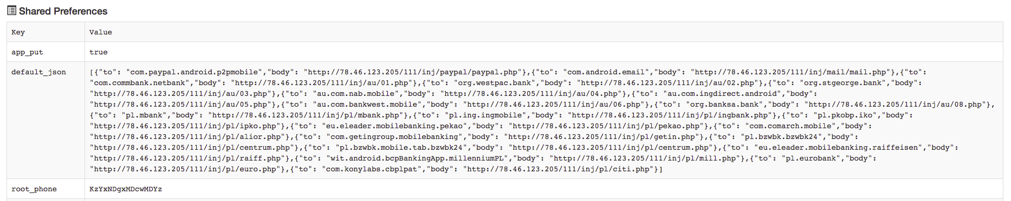
Dynamic Analysis

Slide 18
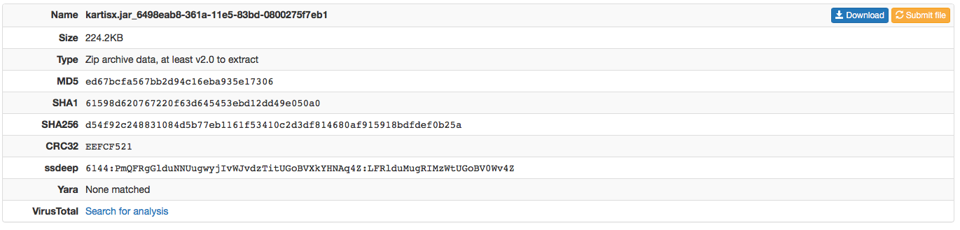
Dynamic Analysis – Unpacking

Slide 19
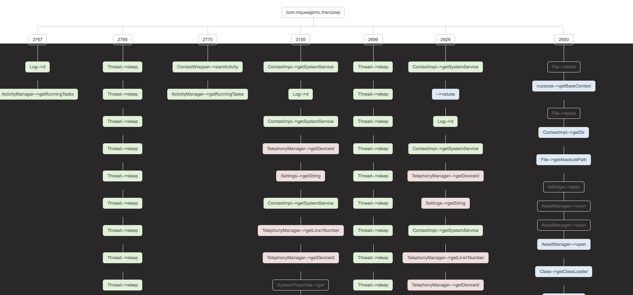
Thread view

Slide 20
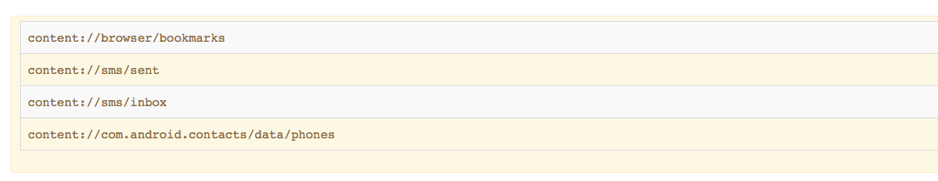
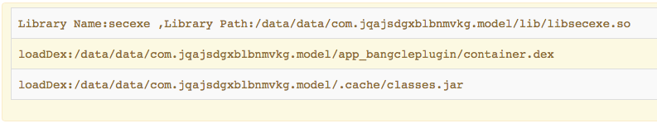
Dynamic Analysis

Slide 21
Dynamic Analysis – Extra Features
Touch Simulator
Screenshots
Anti-Emulator Detection
Contacts Generator
File Collector

Slide 22
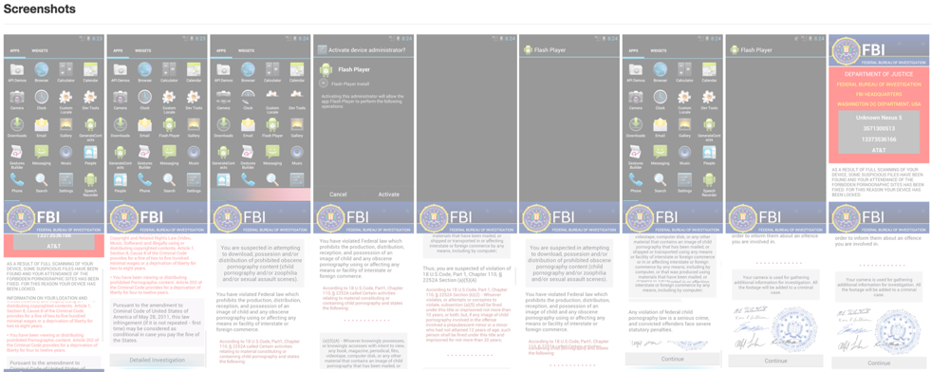
Dynamic Analysis

Slide 23
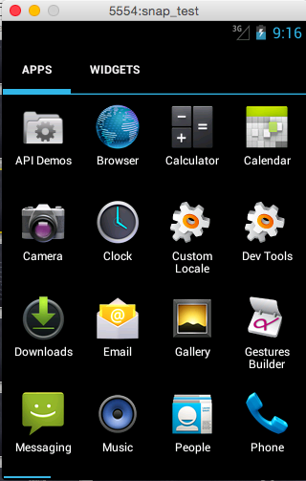
Virtualization Support
Virtualbox
Vmware
ESXi
Kvm
Xen
Android Emulator

Slide 24
Supports ARM and X86 Machines
Category | ARM | x86
Performance | Low - arm emulation | High – x86 virtualization
ARM Native Code | Good | OK - ARM Translation
Exploit Execution | Good - Real ARM Arch | Bad – Exploit relays on architecture for execution, usually breaks
Rooter Malware | Good Option Exploits work | Bad option – exploit usually breaks
Regular Malware(pure java) | Bad option – Low Performance | Good option – High Performance

Slide 25
Traffic Analysis
SSL
UDP
TCP
IRC
DNS
SMTP
HTTP

Slide 26
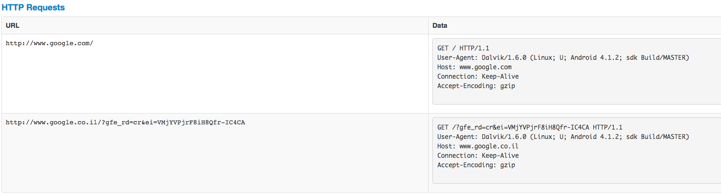
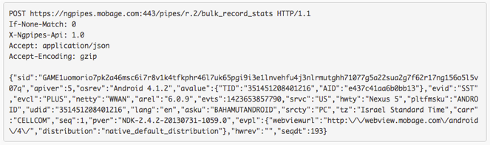
Traffic Analysis

Slide 27
Behavior Analysis
Static
Dynamic
Osint
Detection
Signatures are very useful to give context to the analysis
They simplify the interpretation of the results and automatically identify malware samples of interest.

Slide 28
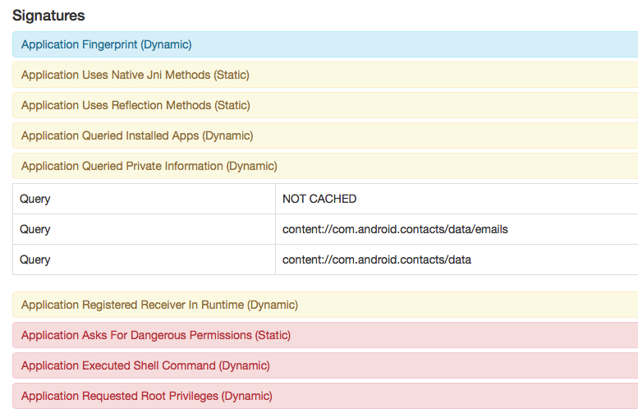
Behavior Analysis

Slide 29
Behavior Analysis – Malware Signature
Powerful signatures that combining static/dynamic/network information to detect malware.
Configuration extraction – on top of our signature we can write config extraction based on Androguard for static or using the dynamic info that we collected during execution for dynamic extraction.
Also if the malware was packed and unpacked during execution we can write the config extraction on the unpacked sample

Slide 30
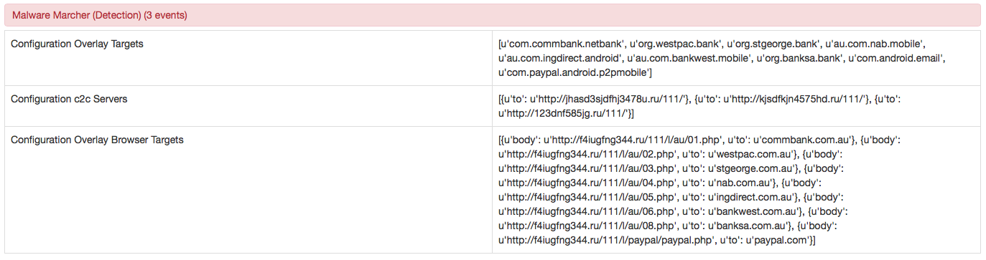
Behavior Analysis – Malware Signature Example

Slide 31
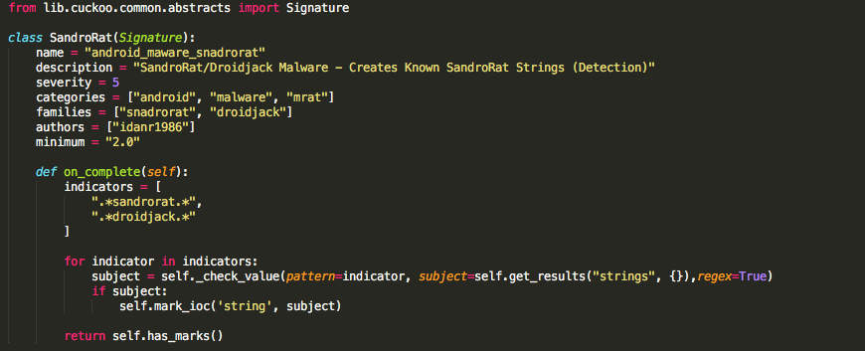
Behavior Analysis – Malware Signature Example

Slide 32
CuckooDroid 2.0 What’s New
Python analysis for x86 machines – Big impact to performance
New User Interface
Automatic unpacking - V
Integration with Maltego
New Behavioral Signatures
File collector – Dropped files
New Behavioral Hooks
Thread view
Android 6.0 support

Slide 33

CuckooDroid Integration with Maltego

Slide 34
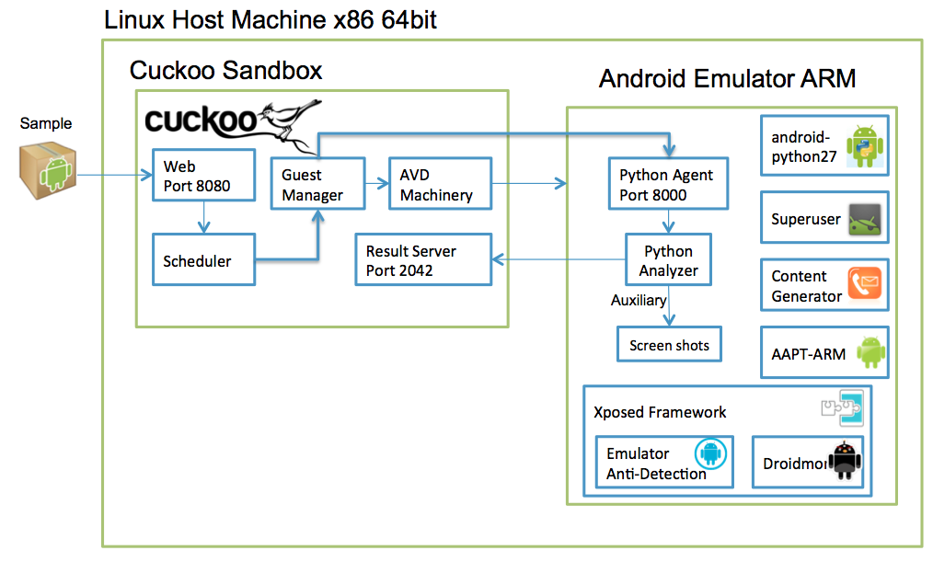
Android Analyzer Architecture
/x86

Slide 35
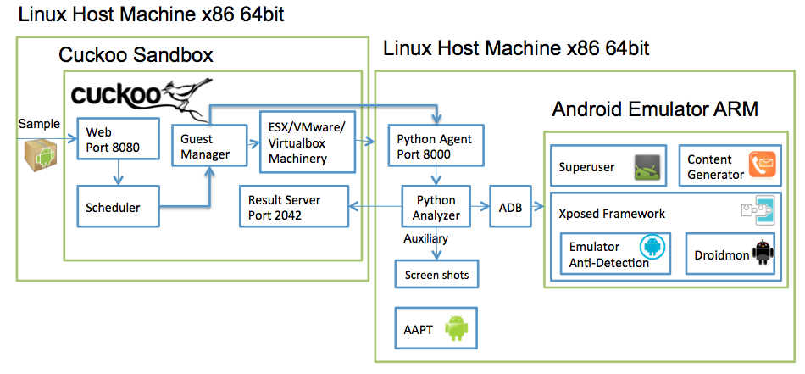
Android On Linux Setup

Slide 36
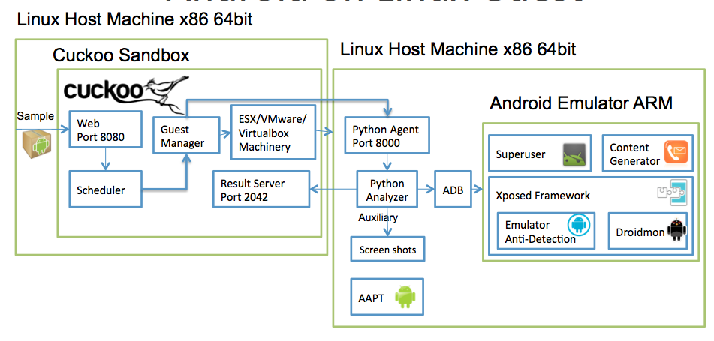
Android x86 Port

Slide 37
Summery
We believe that fighting the growing threat of Android malware should be an industry wide effort
https://github.com/idanr1986/cuckoodroid-2.0

Slide 38

Questions ?

